Slide 1
COTTON LEAF DISEASE DETECTION

Slide 2
TEAM MEMBERS
T.SRIRAM 2103A52070
SD.K.MUKARRAM.AJAZ 2103A52069
V.AKSHAY KUMAR 2103A52039
Under the guidance of
Mr D.Ramesh
Asst. Professor
CS & AI

Slide 3
Introduction
Getting affected by a disease is very common in plants due to various factors such as fertilizers, cultural practices followed, environmental conditions, etc. These diseases hurt agricultural yield and eventually the economy based on it.
Plant Disease is the leading international journal for rapid reporting of research on new, emerging, and established plant diseases.
In general, a plant becomes diseased when it is continuously disturbed by some causal agent that results in an abnormal physiological process that disrupts the plant’s normal structure, growth, function, or other activities.

Slide 4
CONTENTS
1.INTRODUCTION
2.PROBLEM STATEMENT
3.PROPOSED SOLUTION
4.DATASET OVERVIEW
5.LEARNING MODEL
6.CODE IMPLEMENTATION
7.METHODOLOGY
8.CONCLUSION

Slide 5
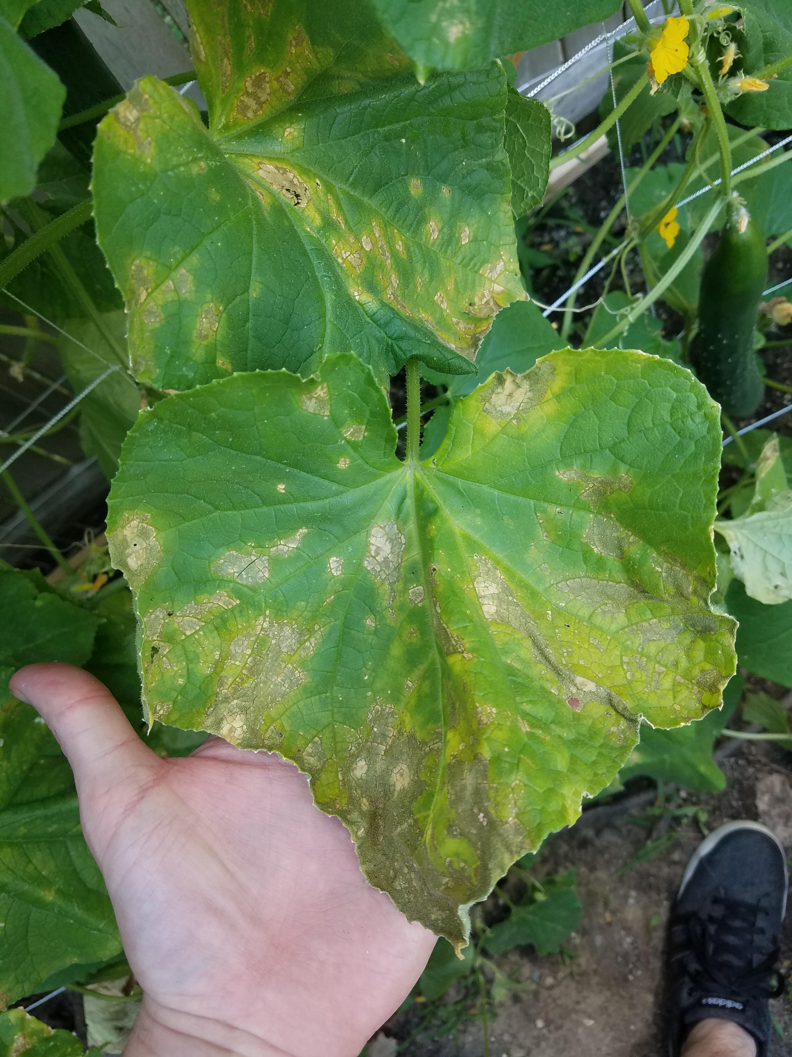
PROBLEM STATEMENT
Crop diseases are a major threat to food security, but their rapid identification remains difficult in many parts of the world due to the lack of the necessary infrastructure.
Plant diseases may limit the kinds of plants and industries in an area.
Plant diseases reduce the quality & quantity of plant production.
Plant diseases may make the crops or plants poisonous to humans and animals, For example: Ergotism & Ergot of rye – caused by Claviceps purpurea.
Plant diseases may cause the financial losses; expenses of labour, chemical cost etc.

Slide 6
PROPOSED SOLUTION
Developing a Machine Learning Algorithm In our proposed system it helps to predict the plant disease .Such that ,the earlier prediction may be helpful to the farmers to get plants cured and medicated.

Slide 7
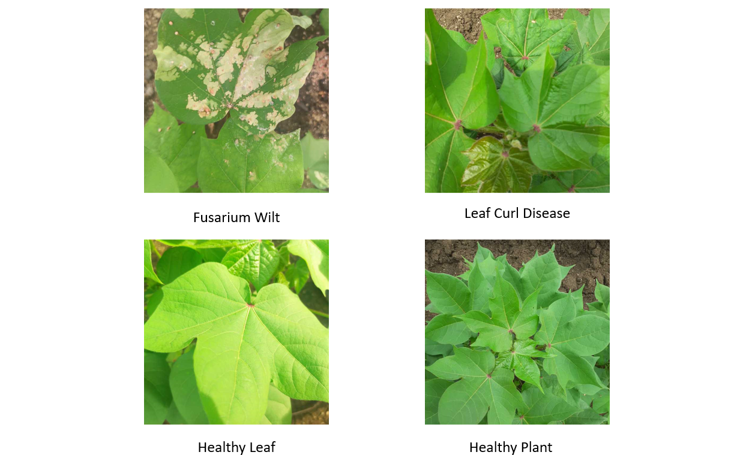
DATA SET OVERVIEW
The dataset is downloaded from Kaggle. and total size is 152 MB.
The dataset contains 3 folders with 1951 train images, 106 test images and 253 validation images.
Each folder is divided into four classes: diseased cotton plant (Fusarium Wilt), diseased cotton leaf (Leaf Curl Disease), fresh cotton plant (Healthy Plant) and fresh cotton leaf (Healthy Leaf).
Each image has a size of 694x694 pixels in JPG format. Here are the sample images of the dataset..

Slide 8
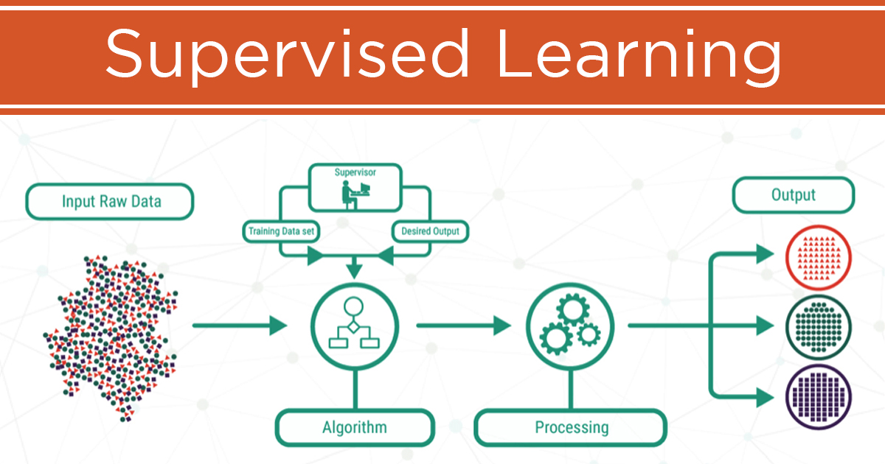
LEARNING MODEL
Supervised learning is the types of machine learning in which machines are trained using well "labelled" training data, and on basis of that data, machines predict the output.
The labelled data means some input data is already tagged with the correct output.
In supervised learning, the training data provided to the machines work as the supervisor that teaches the machines to predict the output correctly.
It applies the same concept as a student learns in the supervision of the teacher.
Supervised learning is a process of providing input data as well as correct output data to the machine learning model.
The aim of a supervised learning algorithm is to find a mapping function to map the input variable(x) with the output variable(y).

Slide 9
CODE IMPLEMENTATION
import os
import numpy as np
import cv2
import matplotlib.pyplot as plt
labels = ['diseased cotton leaf','fresh cotton leaf']
img_size = 200
data = []
def get_training_data(data_dir):
for label in labels:
path=os.path. join (data_dir, label)
class_num = labels.index(label)
print(class_num)
for img in os.listdir (path):
try:
img_arr = cv2.imread(os.path. join (path, img), cv2.COLOR_BAYER_GB2RGB)
resized_arr = cv2.resize(img_arr, (img_size, img_size))
data.append ([resized_arr, class_num])
except Exception as e:
print(e)
return np.array(data)
train = get_training_data('/content/drive/MyDrive/diseased cotton leaf/Colab Notebooks/Cotton Disease/test')
print(data)

Slide 10
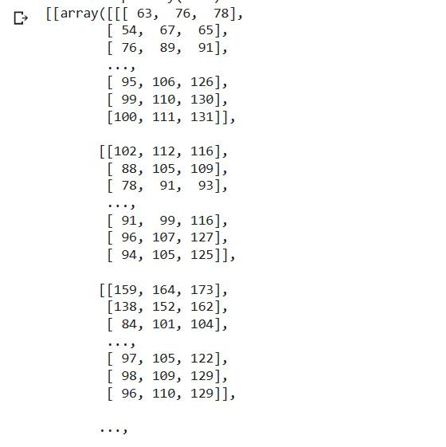
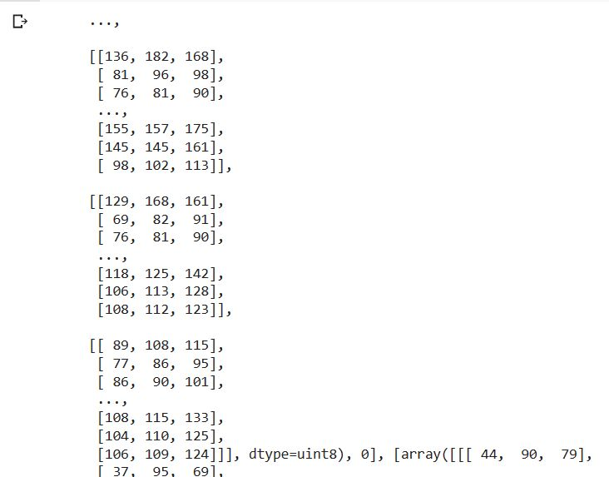
CODE OUTPUT

Slide 11
x=[]
y=[]
#1 means fresh
#0 means disease
count=0
for i in range(len(train)):
if train[i][1]==0:
x.append(train[i][0:2])
else:
y.append(train[i][0:2])
count=count+1
print(count)
y

Slide 12
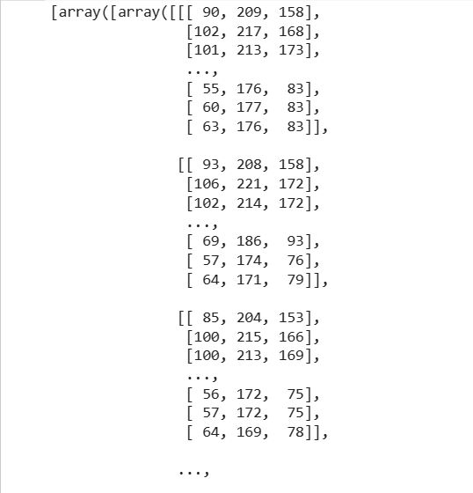
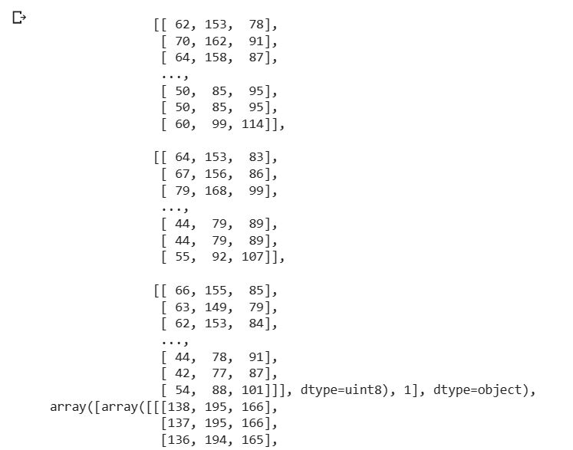

Slide 13
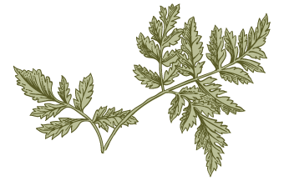
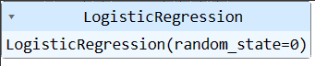
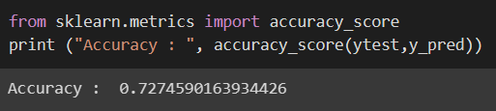
METHODOLOGY
The methods we use for classification type of problems:
Logistic regression: Logistic regression is one of the most popular Machine Learning algorithms, which comes under the Supervised Learning technique. It is used for predicting the categorical dependent variable using a given set of independent variables. A decision tree is a decision support tool that uses a tree-like model of decisions and their possible consequences, including chance event outcomes, resource costs, and utility.
M

Slide 14
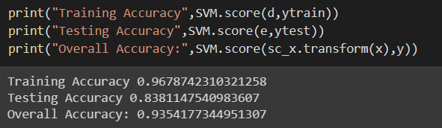
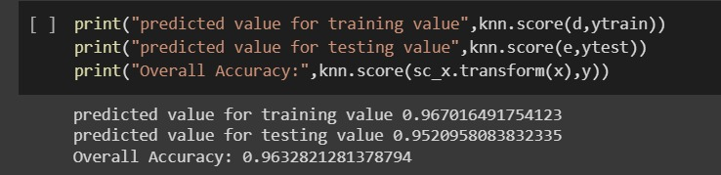
Support Vector Machine:Support vector machines are a set of supervised learning methods used for classification, regression, and outliers detection. All of these are common tasks in machine learning.
K-Nearest Neighbors (KNN) Classifier: KNN is a non-parametric algorithm used for classification and regression tasks. It works by finding the k-nearest data points to a new data point and classifying the new data point based on the majority class of its k-nearest neighbors. KNN is simple and easy to understand, but can be computationally expensive and sensitive to the choice of k and the distance metric used.

Slide 15
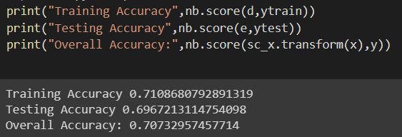
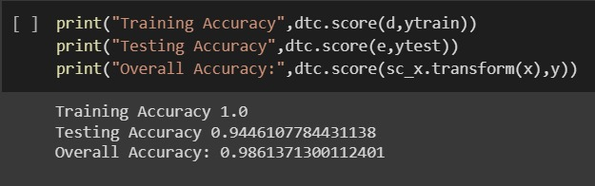
Naive Bayes Classifier: Naive Bayes is a probabilistic algorithm that is used for classification tasks. It is based on Bayes theorem and assumes that all features are independent of each other. Naive Bayes is fast, efficient, and easy to implement, and works well with high-dimensional data sets. It is commonly used in spam filtering, text classification, and sentiment analysis.
Decision Tree Classifier: Decision trees are a non-parametric algorithm used for classification and regression tasks. They work by recursively partitioning the data into subsets based on the most informative feature at each step, until all data points are in their own subset or are classified into a final class. Decision trees are easy to interpret and visualize, but can be prone to overfitting and instability.

Slide 16
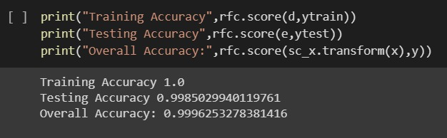
Random Forest classifier:Random forests are an ensemble of decision trees used for classification and regression tasks. They work by building a multitude of decision trees and aggregating their predictions to form a final prediction. Random forests are robust, accurate, and can handle high-dimensional data sets, but can be slow and difficult to interpret.

Slide 17
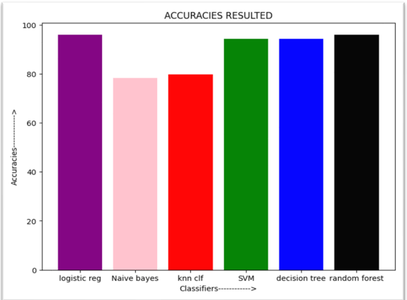
ACCURACY

Slide 18
CONCLUSION
We’ve concluded that plant disease need to be detected as soon as possible where we can use machine learning algorithms to detect if the plant is effected by Disease or not.
By using the above classifiers we got good accuracies in the Random Forest Classifier i.e., 97%.

Slide 19
Thank you

